Slide 1

MINI PROJECT
FINAL REVIEW
Title: Design and Implementation of a Smart Wheelchair for Enhanced Mobility
www.gmrgroup.in
Dept. of Electrical and Electronics Engineering
Presented by
21341A0212
21341A0242
21341A0251
21341A0252
21341A0260
22345A0201
Under the guidelines of
Dr.R.Rama Krishna
Assistant professor

Slide 2
List of Contents
Abstract
Introduction
Literature review table
Research gap
Problem statement
Objectives
Methodology
Project Status
References

Slide 3
Abstract
This abstract introduces a smart and voice-controlled wheelchair designed to enhance mobility for individuals with disabilities. The wheelchair integrates cutting-edge technology, including sensors and voice recognition systems, enabling users to navigate effortlessly and independently. By employing intuitive voice commands, users can control the wheelchair's movements, ensuring a user-friendly and efficient mode of transportation. Its includes WIFI module which was connected to mobile through WIFI option. The integration of smart features not only promotes accessibility but also enhances the overall quality of life for individuals facing mobility challenges.

Slide 4
Introduction
In the pursuit of fostering inclusivity and independence for individuals with mobility impairments, technological advancements have paved the way for innovative solutions. Among these, the development of a smart and voice-controlled wheelchair emerges as a promising breakthrough. This groundbreaking assistive technology leverages state-of-the-art sensors and voice recognition systems to empower users with enhanced control and autonomy. By seamlessly integrating intuitive voice commands into the wheelchair's functionality, this solution seeks to redefine the traditional limitations faced by individuals with disabilities, offering a newfound sense of freedom and accessibility. This introduction sets the stage for a detailed exploration of the features and benefits that this cutting-edge wheelchair brings to the realm of assistive devices, ultimately aiming to improve the overall quality of life for those with mobility challenges.

Slide 5
Literature Review
S.No | Title of the paper | Year | Remarks
1. | Voice controlled intelligent wheelchair. | 2007 | A grammar-based is used in our system. Three type commands, the basic reaction command, the short moving reaction command, and the veriﬁcation command.
2. | Voice controlled automatic wheelchair | 2018 | The system has two segments, specifically; hardware and programming. The hardware contains an embedded structure that relies upon Arduino Uno board, a Bluetooth Module, Motor Driver and an Android phone.
3. | Iot based smart wheelchair for disabled people | 2021 | These types of wheelchairs are gradually replacing the traditional wheelchairs; however, their expensive costs are preventing a large size of disabled people from having one.
4. | Speech controlled automatic wheelchair | 2013 | This paper implemented design of voice control module for a motorized wheelchair which works based on the speech processing technique and local map navigation system and the simulation result shows the robustness of the voice recognition module.

Slide 6
Problem Statement
Despite significant strides in assistive technologies, individuals with mobility impairments often encounter barriers to independent mobility. Conventional wheelchairs, while crucial for basic transportation, face limitations in providing a seamless and intuitive user experience. Users may struggle with navigation, particularly in complex environments, hindering their ability to fully engage with society. This underscores the need for a more sophisticated and user-friendly solution that leverages smart and voice-controlled technology. Addressing these challenges, the proposed smart and voice-controlled wheelchair aims to revolutionize mobility assistance for individuals with disabilities, offering a novel approach to enhance their independence and overall quality of life.

Slide 7
Objectives
Create voice-controlled wheelchair enhancing independent navigation in diverse environments.
Utilize voice recognition for intuitive wheelchair control, enhancing user experience.
Incorporate sensors for obstacle detection, ensuring secure wheelchair navigation.
Research remote monitoring for wheelchair status tracking, aiding prompt assistance.
Explore economically viable smart wheelchair solutions for diverse accessibility needs.

Slide 8
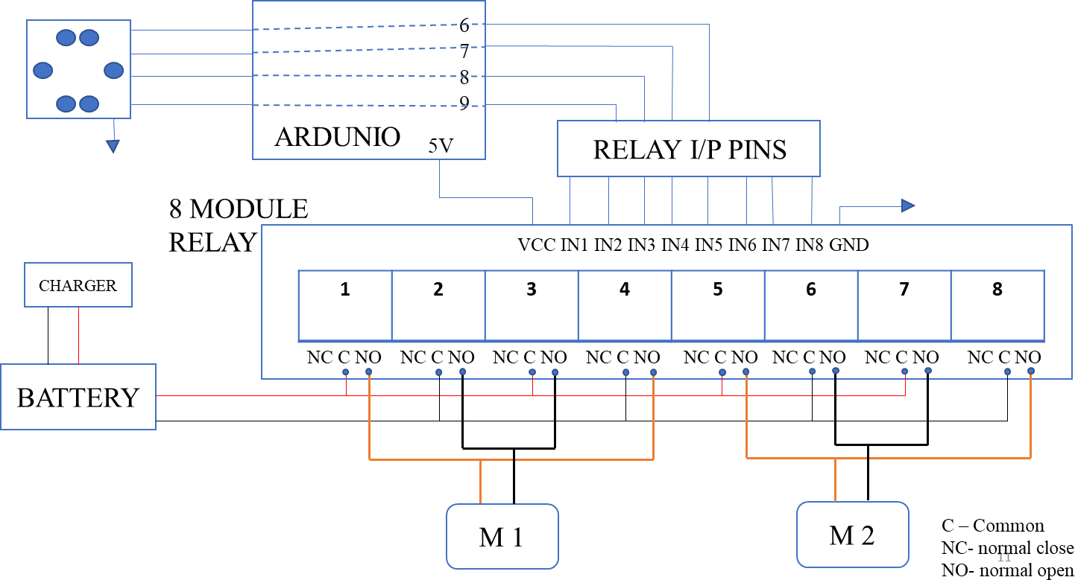
Methodology

Slide 9
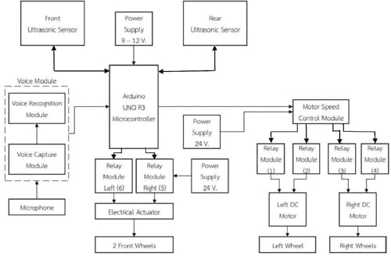
Contd..

Slide 10
Project status
Project prototype was almost done.
Report was submitted.
On load it was running.

Slide 11
Future scope
Integration with IoT Devices.
Real-time Health Monitoring.
Smart Navigation and Obstacle Avoidence.
Data Analytics and Machine Learning.
Collaboration with Healthcare Providers.

Slide 12
References
Nishimori, Masato, Takeshi Saitoh, and Ryosuke Konishi. "Voice controlled intelligent wheelchair." In SICE Annual Conference 2007, pp. 336-340. IEEE, 2007.
Umchid, Sumet, Pitchaya Limhaprasert, Sitthichai Chumsoongnern, Tanun Petthong, and Theera Leeudomwong. "Voice controlled automatic wheelchair." In 2018 11th Biomedical Engineering International Conference (BMEiCON), pp. 1-5. IEEE, 2018.
Al Shabibi, Maryam Amur Khalfan, and Suresh Manic Kesavan. "Iot based smart wheelchair for disabled people." In 2021 International Conference on System, Computation, Automation and Networking (ICSCAN), pp. 1-6. IEEE, 2021.
Sivakumar, M. Senthil, Jaykishan Murji, Lightness D. Jacob, Frank Nyange, and M. Banupriya. "Speech controlled automatic wheelchair." In 2013 Pan African international conference on information science, computing and telecommunications (PACT), pp. 70-73. IEEE, 2013.

Slide 13
End

